Slide 1

Spring 2022
Hypothesis testing
& p-values
Programming and Data Analysis for Modern Neuroscience
NEU 365P/385L
Marcel Goldschen-ohm
Assistant Professor in the Department of Neuroscience, The University of Texas at Austin

Slide 2
Learning Objectives
You will…

Slide 3


Population vs. Sample Distribution
$$μ$$
Species
$$σ$$
life expectancy

Slide 4


Population vs. Sample Distribution
$$μ$$
Species
$$σ$$
life expectancy
$$μ$$
Sample of $n$ individuals
mean life expectancy

Slide 5
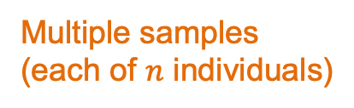

Population vs. Sample Distribution
$$μ$$
Species
$$σ$$
life expectancy
$$μ$$
$$\frac{σ}{\sqrt{n}}$$
Multiple samples
(each of $n$ individuals)
mean life expectancy

Slide 6
Central Limit Theorem
$$μ$$
Species
$$σ$$
life expectancy
$$μ$$
Expected by CLT
$$\frac{σ}{\sqrt{n}}$$
Multiple samples
(each of $n$ individuals)
mean life expectancy

Slide 7

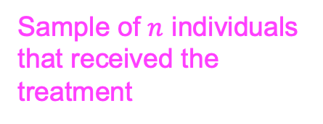

Does an experimental treatment affect life expectancy?
$$μ$$
Expected for normal individuals
Sample of $n$ individuals that received the treatment
$$\frac{σ}{\sqrt{n}}$$
mean life expectancy
Yes? No? Maybe?

Slide 8
Does an experimental treatment affect life expectancy?
$$μ$$
Expected for normal individuals
Sample of $n$ individuals that received the treatment
$$\frac{σ}{\sqrt{n}}$$
mean life expectancy
Yes? No? Maybe?

Slide 9
Does an experimental treatment affect life expectancy?
$$μ$$
Expected for normal individuals
Sample of $n$ individuals that received the treatment
$$\frac{σ}{\sqrt{n}}$$
mean life expectancy
Yes? No? Maybe?

Slide 10
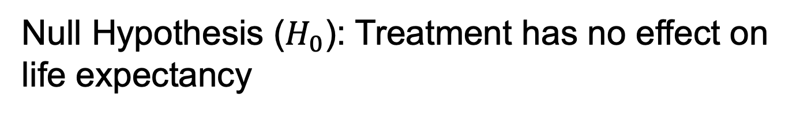
Null Hypothesis ($H_{0}$): Treatment has no effect on life expectancy
$$μ$$
Expected for normal individuals
Sample of $n$ individuals that received the treatment
$$\frac{σ}{\sqrt{n}}$$
mean life expectancy
Start by assuming that $H_{0}$is true. i.e., the mean life expectancy of the treatment group is explained purely by random variation.

Slide 11
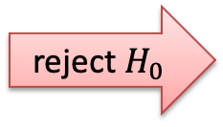





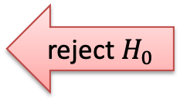
Decide whether to reject the null hypothesis
$$α=0.05$$
$$1−α$$
$$\frac{α}{2}$$
$$\frac{α}{2}$$
mean life expectancy
reject $H_{0}$
do not reject $H_{0}$
reject $H_{0}$

Slide 12

p-value
p-value: Probability of observing a value as extreme or more extreme assuming the null hypothesis is true.
$$p$$
mean life expectancy
reject $H_{0}$
do not reject $H_{0}$
reject $H_{0}$

Slide 13


Get a p-value from a probability distribution
$$x$$
$$p=SF(x)$$
mean life expectancy

Slide 14

Get a p-value from a probability distribution
$$x$$
$$p=CDF(x)$$
mean life expectancy

Slide 15
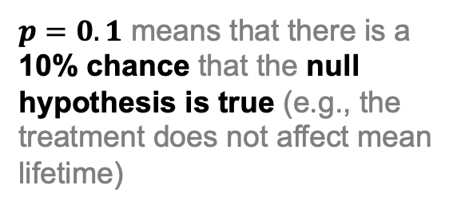
p-value common misconceptions
$p=0.1$ means that there is a 10% chance that the null hypothesis is true (e.g., the treatment does not affect mean lifetime)

Slide 16
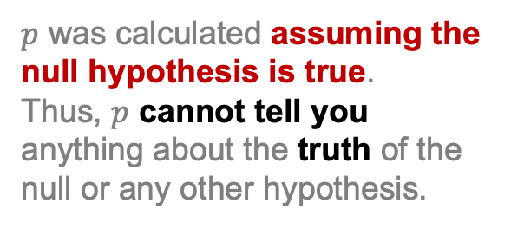
p-value common misconceptions
$p=0.1$ means that there is a 10% chance that the null hypothesis is true (e.g., the treatment does not affect mean lifetime)
$p$ was calculated assuming the null hypothesis is true.
Thus, $p$ cannot tell you anything about the truth of the null or any other hypothesis.

Slide 17
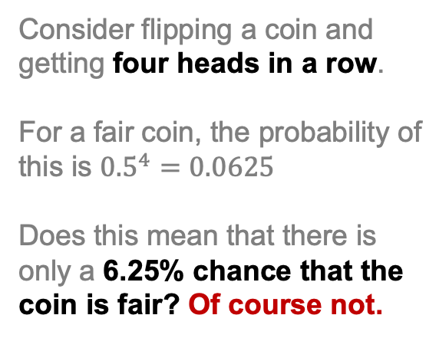
p-value common misconceptions
$p=0.1$ means that there is a 10% chance that the null hypothesis is true (e.g., the treatment does not affect mean lifetime)
Consider flipping a coin and getting four heads in a row.
For a fair coin, the probability of this is ${0.5}^{4}=0.0625$
Does this mean that there is only a 6.25% chance that the coin is fair? Of course not.

Slide 18
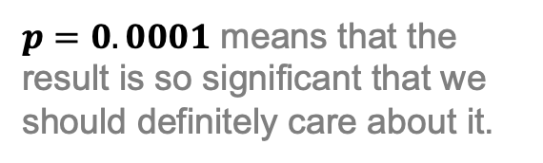
p-value vs. effect size
$p=0.0001$ means that the result is so significant that we should definitely care about it.

Slide 19
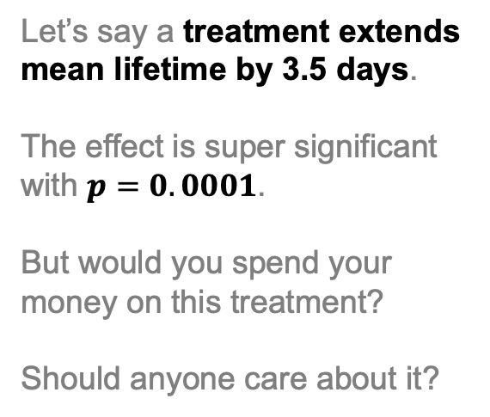
p-value vs. effect size
$p=0.0001$ means that the result is so significant that we should definitely care about it.
Let’s say a treatment extends mean lifetime by 3.5 days.
The effect is super significant with $p=0.0001$.
But would you spend your money on this treatment?
Should anyone care about it?

Slide 20
p-value common misconceptions
For some more common misconceptions regarding p-values, see https://www.youtube.com/watch?v=QAwYwcSTdLs
!!! WARNING !!! misinformation is everywhere
There are many p-value YouTube tutorials that fall prey to these misconceptions, so beware.

